Slide 1
INIT:
Translate each word with google translate
& download mp3 in the original language
Get from user words list
Store in DB
Functions:
Create user
Add word list
Get translate
Get mp3
Strone in DB
gTTS
googletrans 3.0.0

Slide 2
Main CANVAS:
X
-
Name
Add word
Stats
Classify
Study
Src language
Dst language
Word quantity

Slide 3
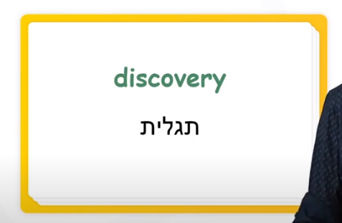
Classify:
User will get list of unclassified words and move as much he wants to the 3 classes.
Classifying
New
Familiar
known

Slide 4
Classify CANVAS:
X
-
Name
known
Word
New
Familiar
known
Back

Slide 5
Study:
Select number of studying words
Show translate first
Show word in green & play mp3

Slide 6
Study CANVAS:
X
-
Name
Start
known
Word
Trans
Back

Slide 7
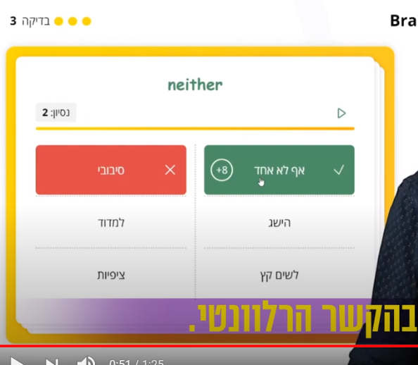
Test:
Appears after study session
Will show original word with few translate option
User will attempt to guess the right translation
Word will get score by the attempt number
Pass score to DB

Slide 8
Study CANVAS:
X
-
Name
Start
known
Word
Attempts: 0
Score: +8
Trans1
Trans2
Trans3
Trans4
Trans5
Trans6
Back

